Slide 1
By: Sophia Lee and Sione Markarian

Slide 2
What is the Academy of Science and Medicine?
Career pathway program offering students the opportunity to explore the various careers available in the fields of science and medicine.
10th, 11th, and 12th graders
9th graders can take Medical Biology

Slide 3
The Big Three
Academy Picnic
Health Career Night
End of the Year Celebration

Slide 4
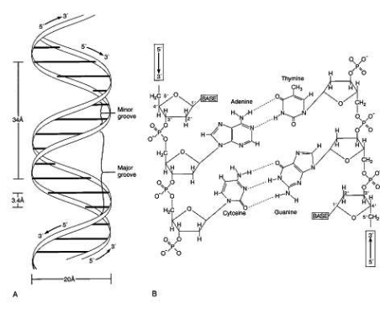
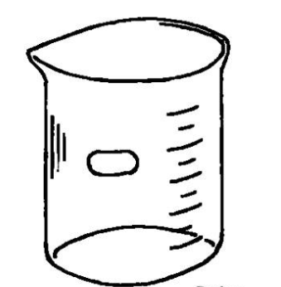
What classes do the Academy students take?

Slide 5
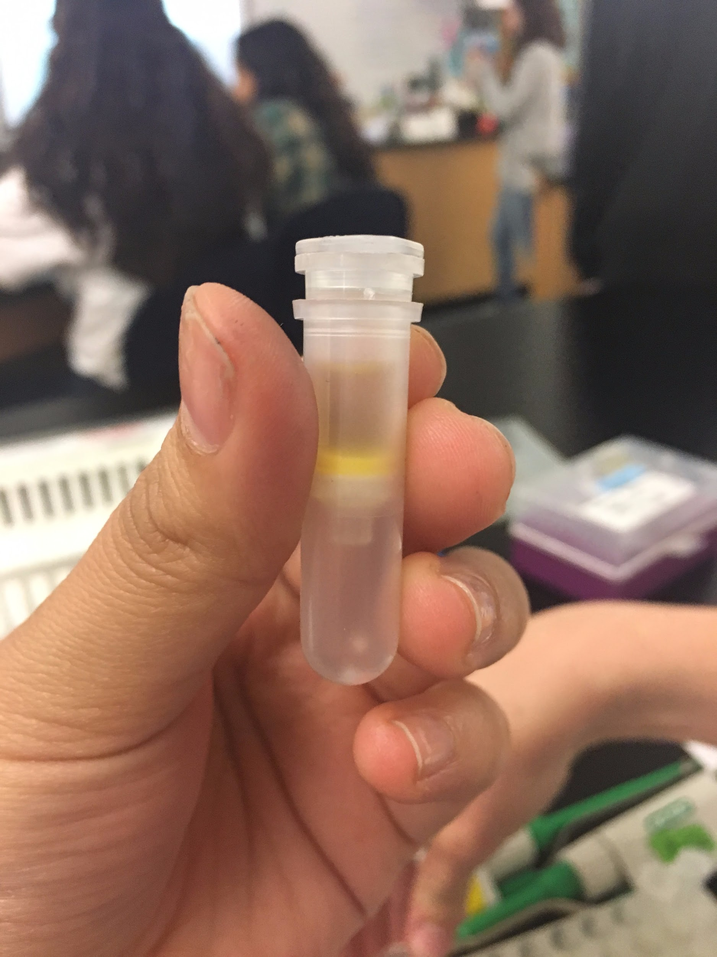
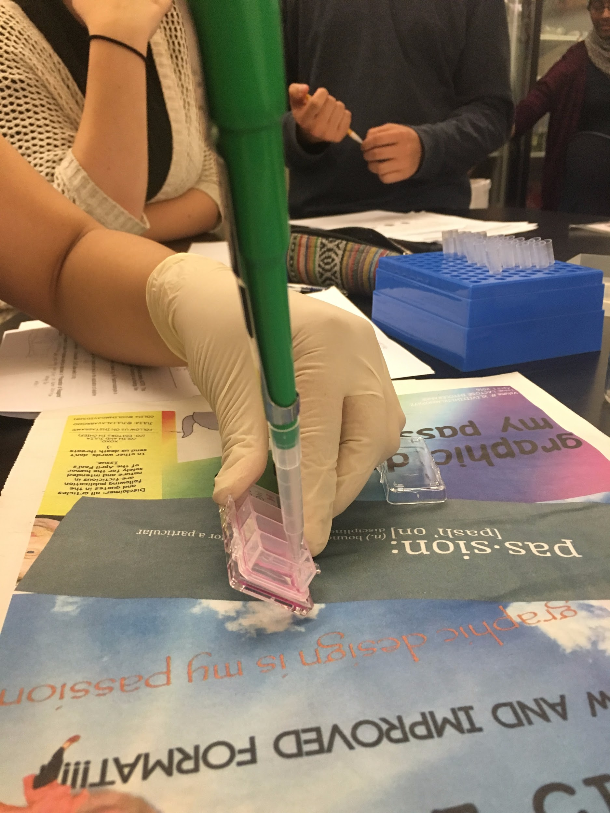
10th grade
Biotechnology → 1 year; Required
Pure Academy classes
English and History

Slide 6
11th grade
CTE → 2 semesters required
Medical Terminology/Office Medical Records (GCC Class)
EKG, Disease Process
Science Research Class
Lifeguarding/Water Safety
OR
1 year of Sports Medicine or Kinesiology
1 year of Robotics
Notes:
Dedication to teachers and less about requirements and more pics and personal stories

Slide 7
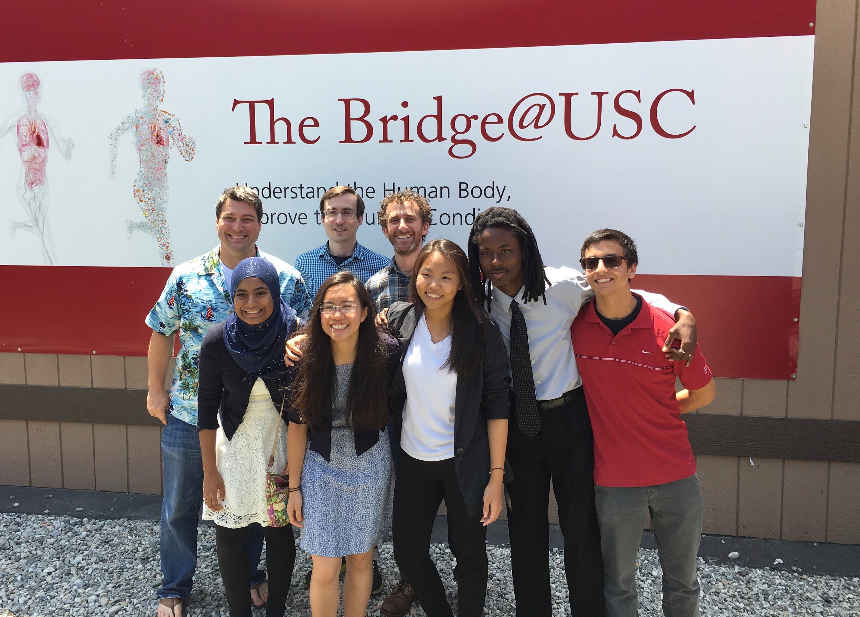
12th grade
No required Academy classes but must have a science class (AP Psychology/Psychology accepted)
20 hours of participation in Academy activities
30 hours of tutoring “at risk” Academy students
40 hours of internship

Slide 8
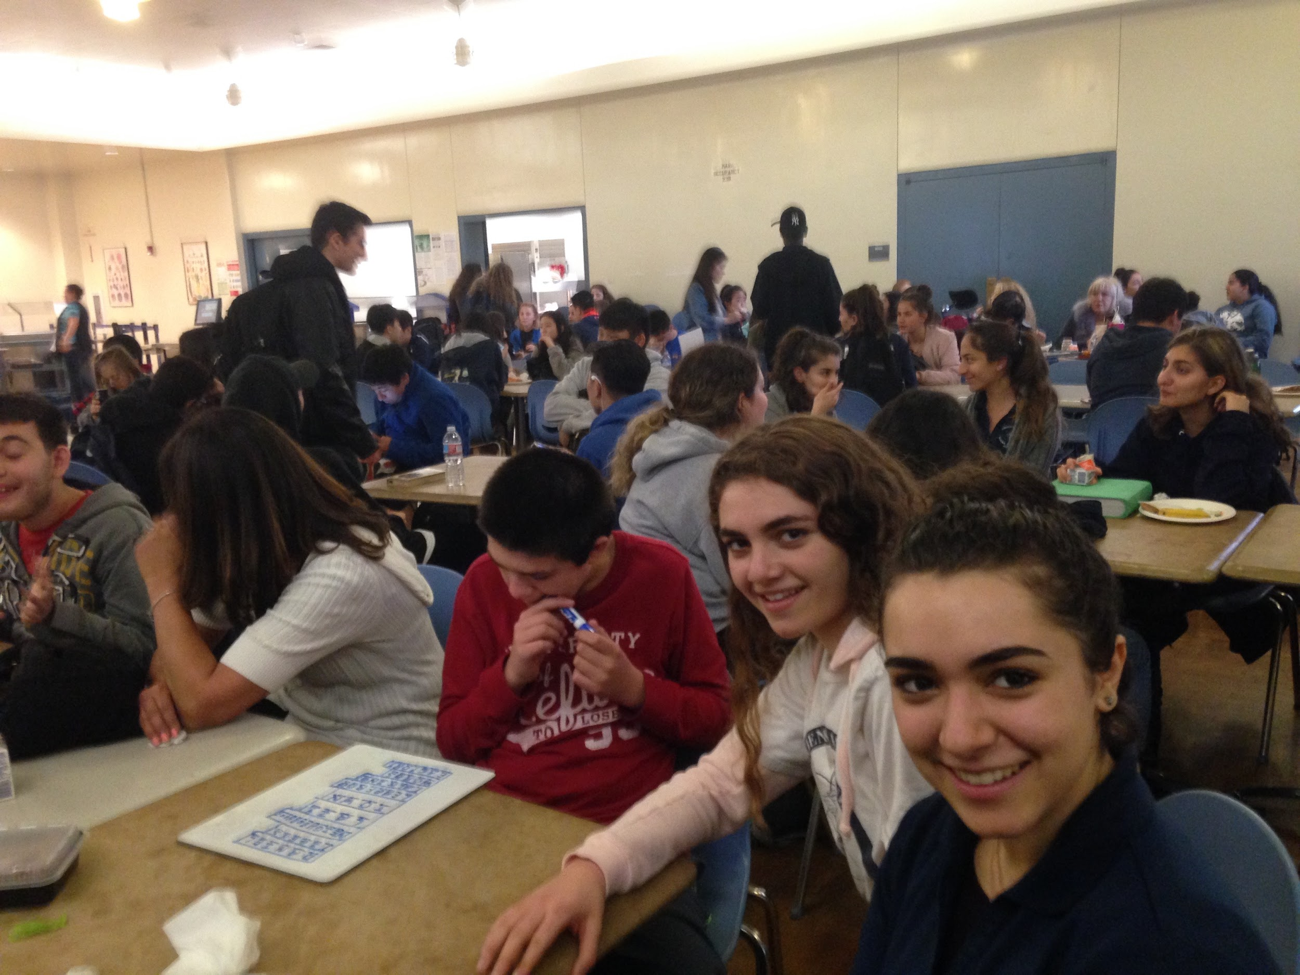
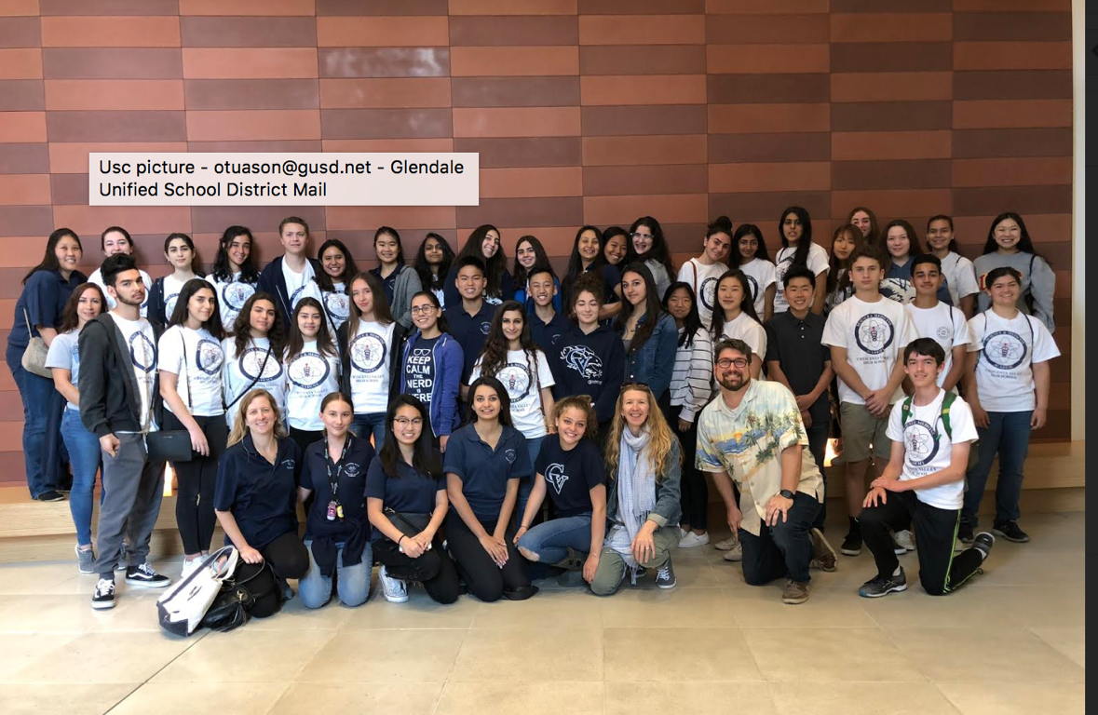
Events we have throughout the year
Academy Field Trips
Academy Lunch Presentations
Academy Movies
Academy Fundraising events (i.e. Jamba Juice, Baja Fresh, etc)
On-the-job training (CTE students)
CV’s emergency disaster drill
Socials

Slide 9
All that work for…
A red stethoscope Medical Dictionary

Slide 10
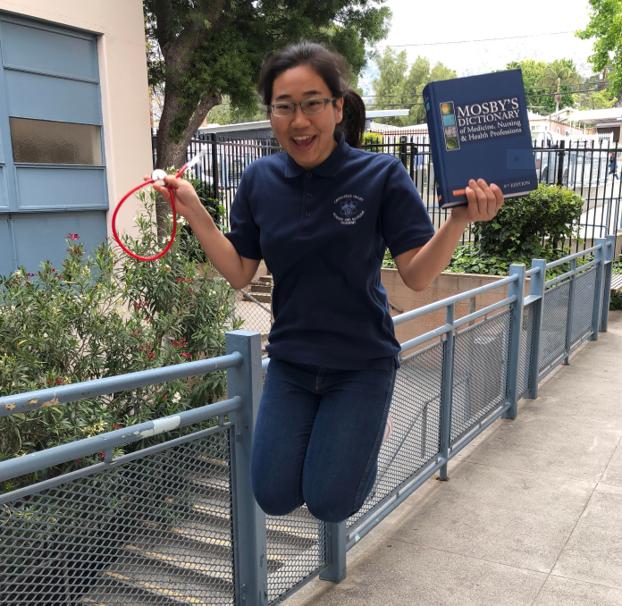

Slide 11
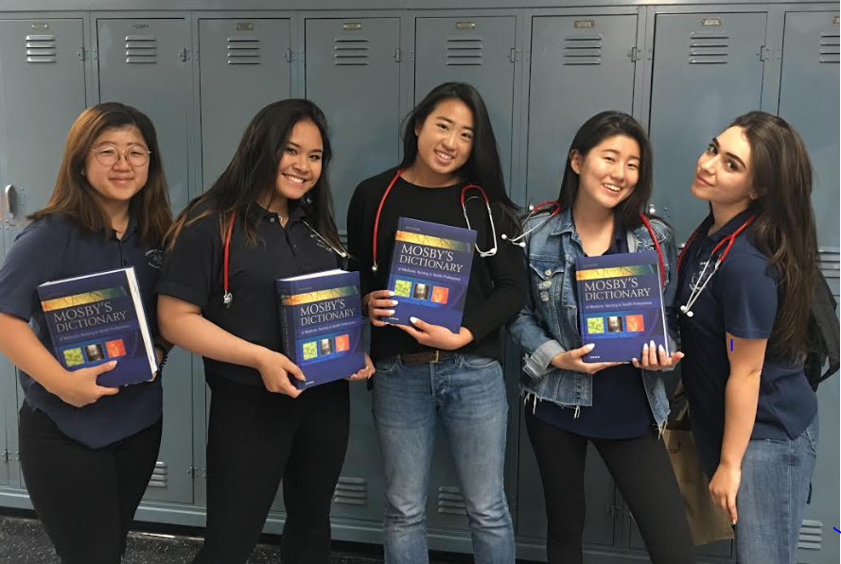
WE DID IT!

